Slide 1
Requirements
VSCode (https://code.visualstudio.com/download )
Gcloud CLI (https://cloud.google.com/sdk/docs/install#mac )
Python (should be already installed I guess)
That’s all :)

Slide 2
1) Authorize in Gcloud CLI
Run gcloud auth login command in your terminal
It will redirect you to the browser, where you would need to login into your Gmail account of choice. If it didn’t automatically redirected you - paste the link it provided into search bar of you browser
After following the instructions in the browser, you should see:
You are now logged in as [your_gmail@gmail.com].
You successfully logged into your account

Slide 3
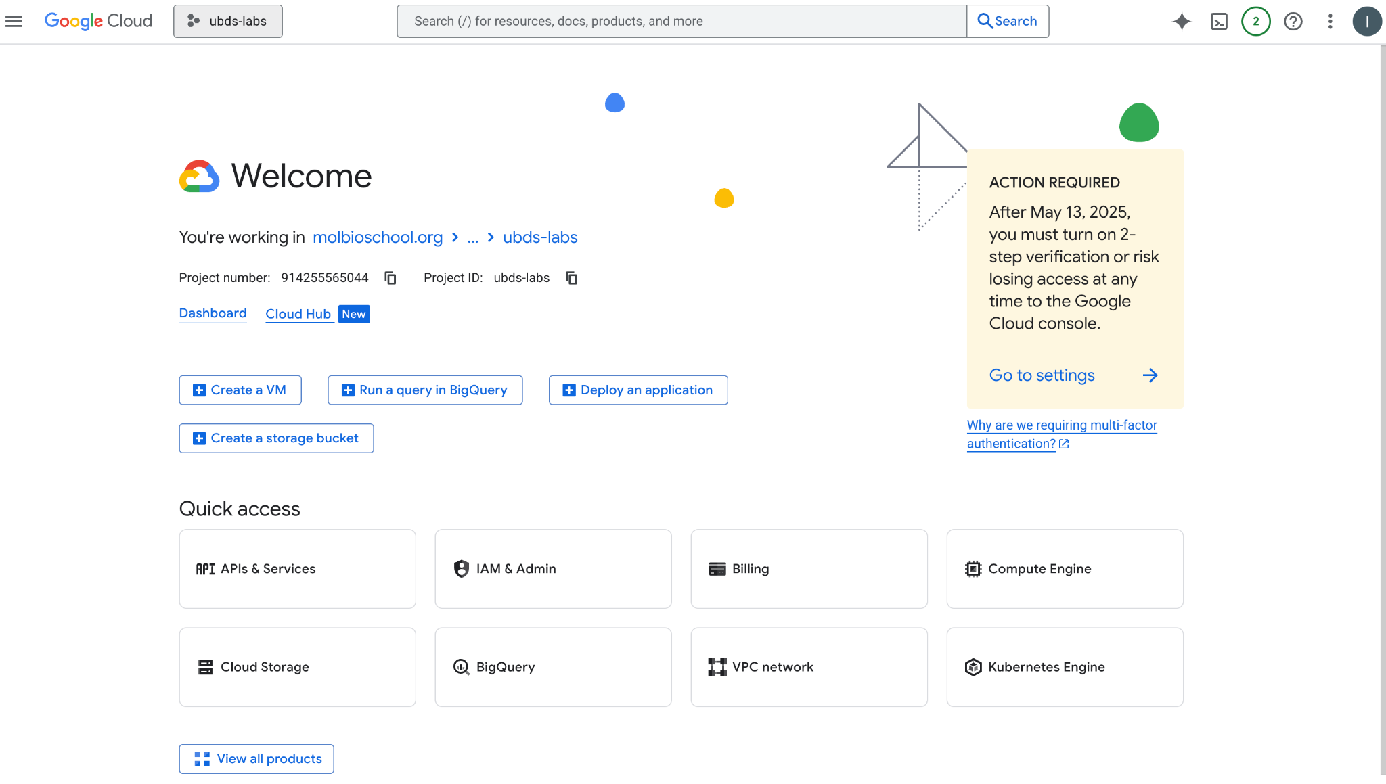
2) GCP projects
Let’s visit GCP console, which is kinda the online version of gcloud CLI https://console.cloud.google.com/ . You should see something like this:
The most important here right now - is the button to choose / switch projects

Slide 4
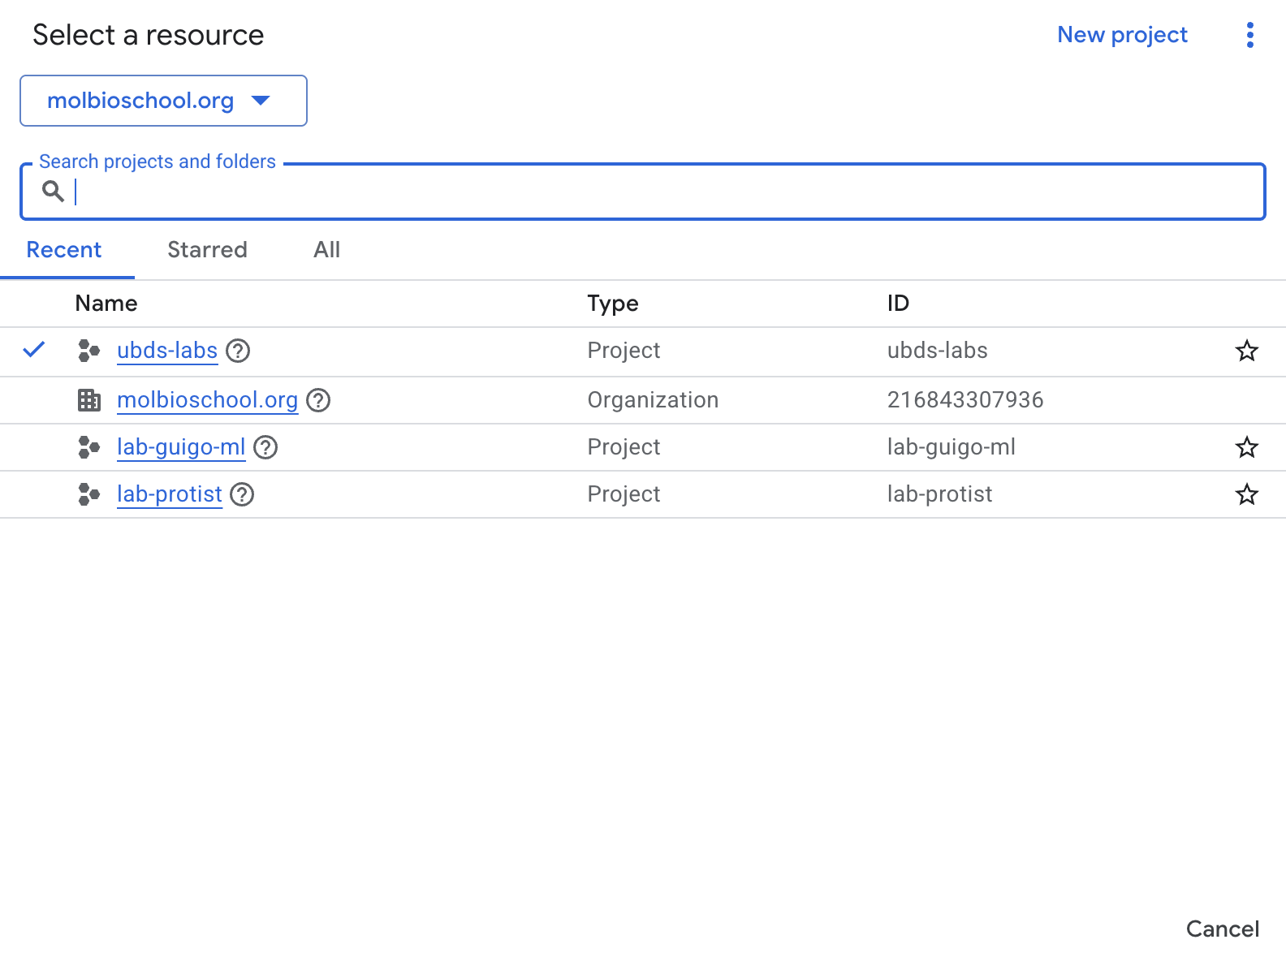
2) GCP projects
2) When you’ll click on it, you should see something like this:
Current organisation - choose molbioschool.org
Current project - choose ubds-labs
Here the PROJECT ID of your project is specified, for our ubds-labs it is the same as project name

Slide 5
3) GCP Compute Engine
3) After you clicked on ubds-labs, we should be here again. Let’s navigate to the Compute Engine to see the available instances

Slide 6
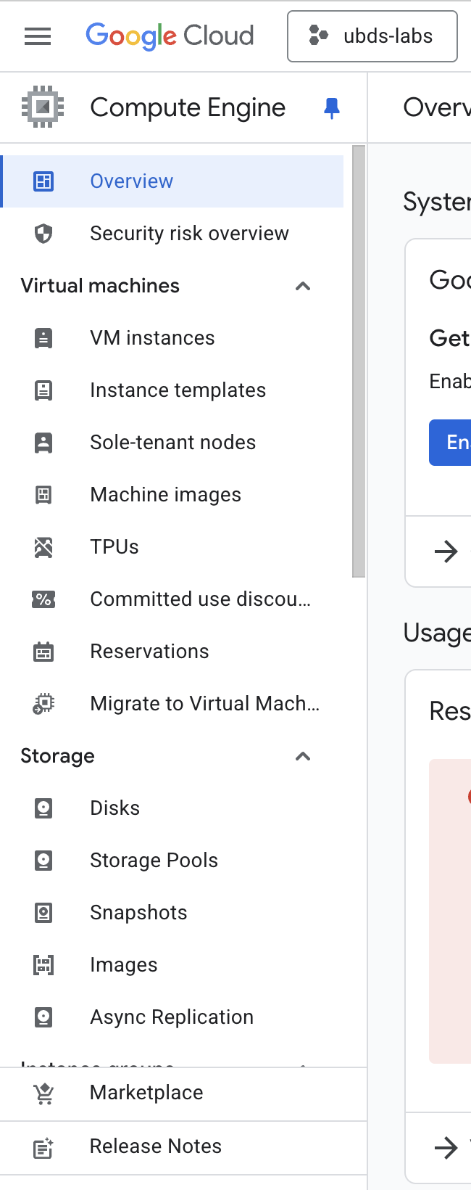
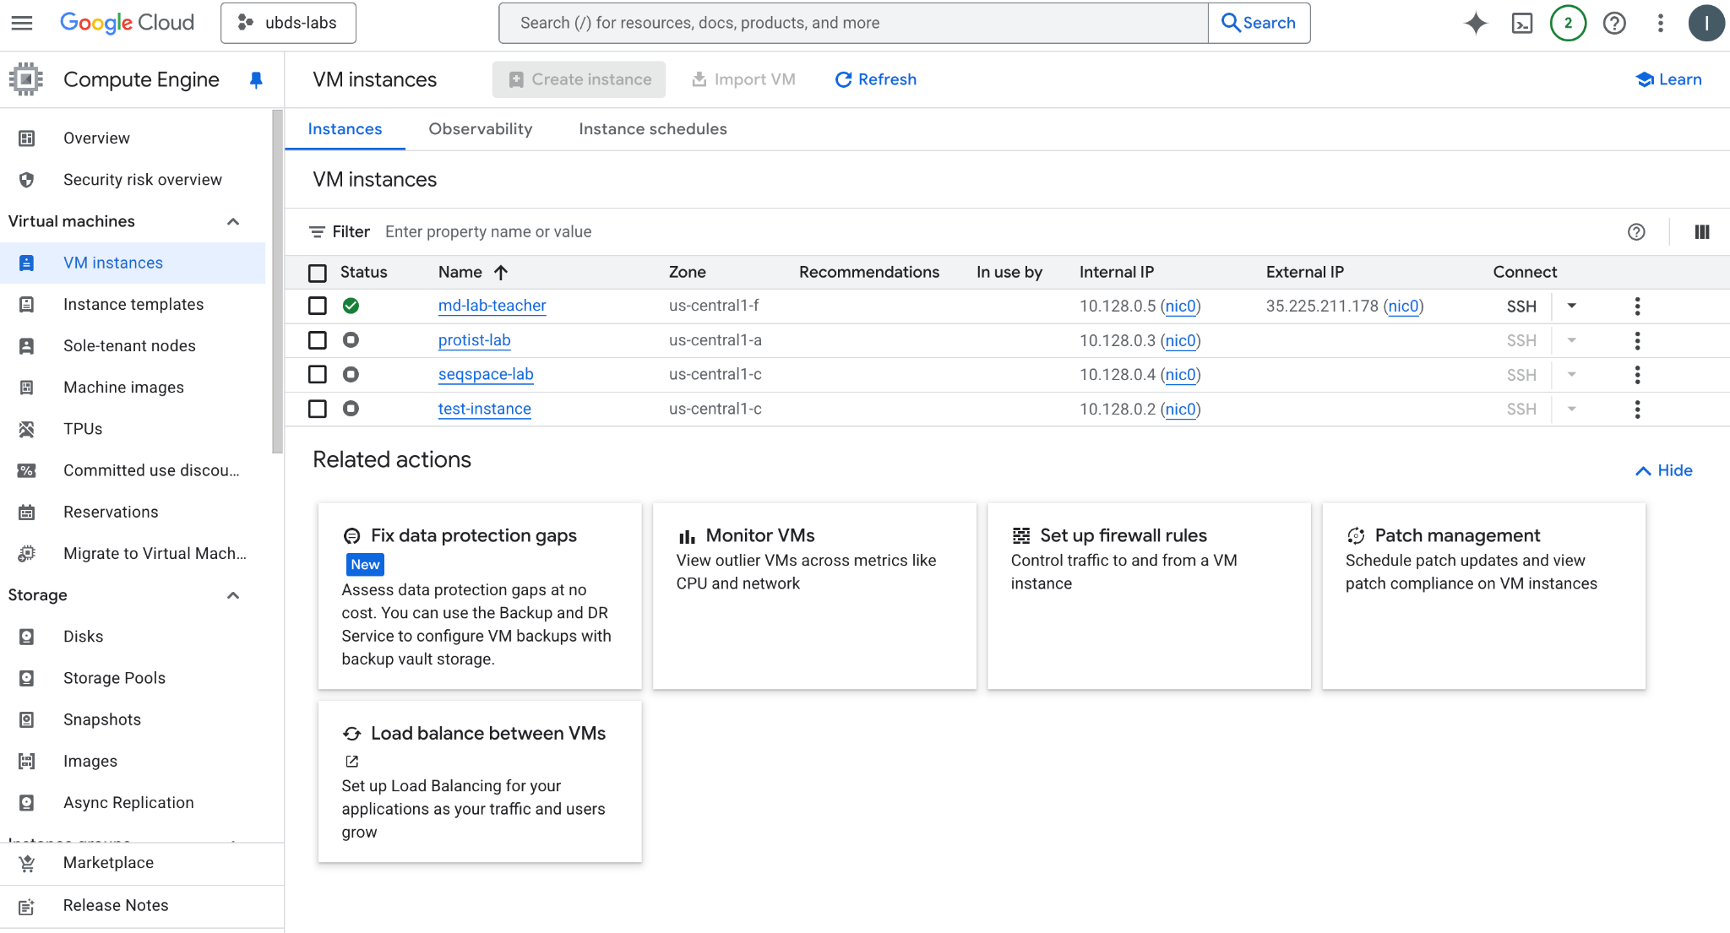
3) GCP Compute Engine
4) You should see this
menu on the left side:
5) Click on it and see the list of all VMs in this project

Slide 7
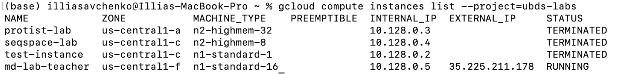
4) Gcloud CLI Compute
Let’s return to our terminals and do the same thing with gcloud CLI
Run gcloud compute instances list --project=ubds-labs
You’ll see the list of VMs in ubds-labs project:
4) My machine is called md-lab-teacher. At the start of the project, I’ll ask Roy to create the machines for each of you, so you’ll have your own VM.

Slide 8
4) Let’s finally connect to instance!
We’re gonna use VSCode to connect to VMs an work with them - because it is super easy and convenient to do anything remotely via VSCode
But first, let’s connect to the VM in terminal (for two reasons: first -just to try, and second - we need to add the address of the machine to our ssh_known_hosts_list file)
To connect to the instance, run this command in the terminal:
gcloud compute ssh md-lab-teacher --project=ubds-labs --zone=us-central1-f --tunnel-through-iap
###NOTE: use the name of your instance instead of md-lab-teacher
You’ll end up in your home directory on the VM

Slide 9
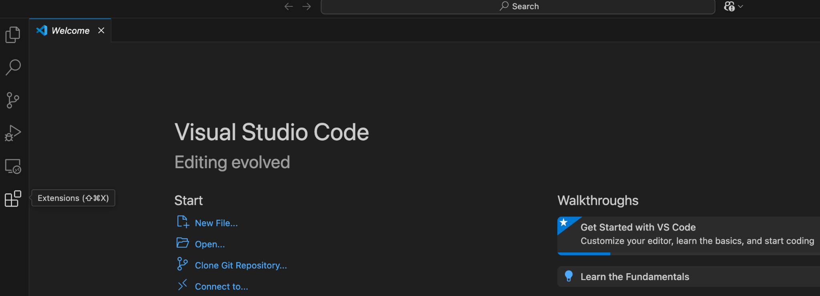
5) VSCode
Great, we connected to the instance via terminal, but let’s make it via VSCode.
Open your VSCode, and navigate to the Extensions Menu:

Slide 10
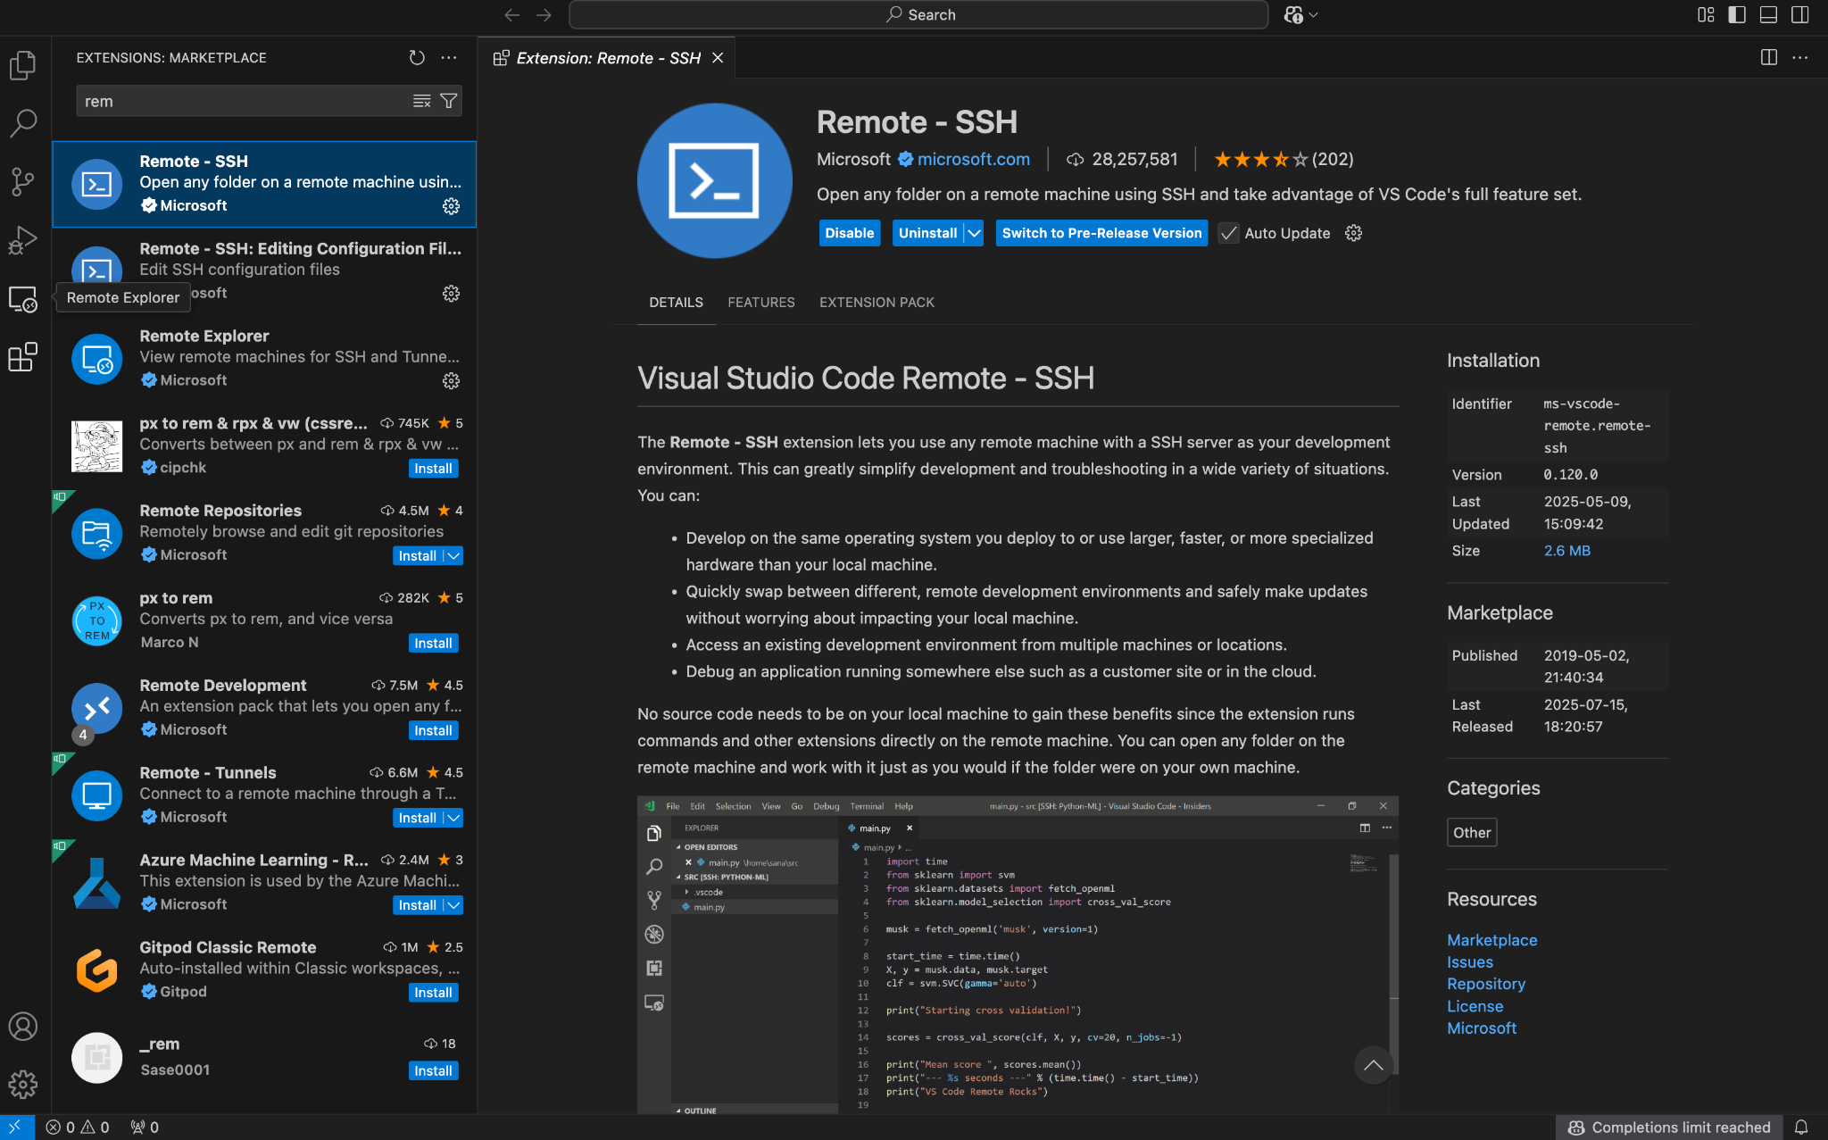
5) VSCode: Remote - SSH
Search and install the Remote - SSH Extension
2) You then should see the Remote Explorer Option on left-side menu. Click on it.

Slide 11
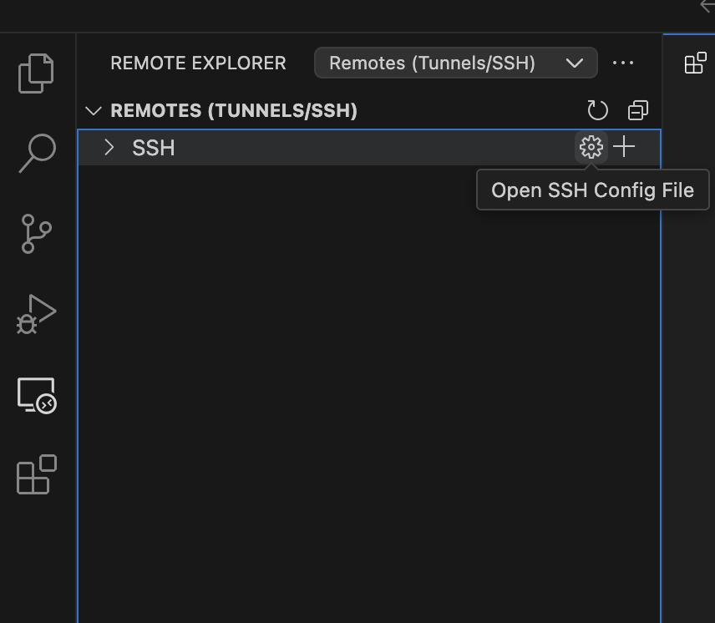
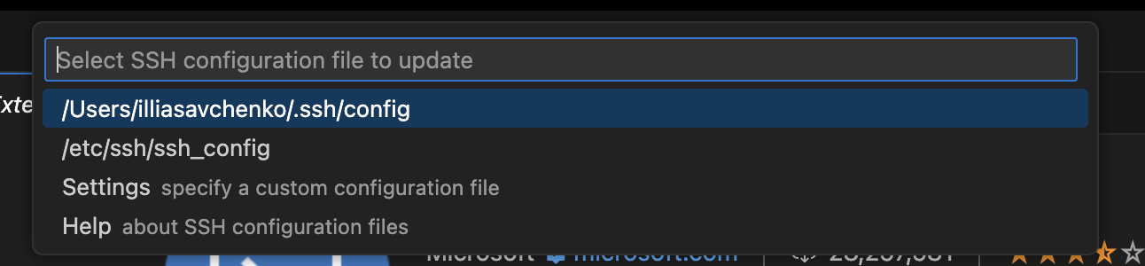
5) VSCode: Remote Explorer bar
Open …./username/.ssh/config
2) It’ll be blank at first

Slide 12
5) VSCode: Generate config for connection to your machine
Return to the terminal and run the command you used to connect to the VM, but with --dry-run flag at the end:
gcloud compute ssh md-lab-teacher --project=ubds-labs --zone=us-central1-f --tunnel-through-iap --dry-run
Copy the output of this command:
/usr/bin/ssh -t -i /Users/illiasavchenko/.ssh/google_compute_engine -o CheckHostIP=no -o HashKnownHosts=no -o HostKeyAlias=compute.8043307278296569369 -o IdentitiesOnly=yes -o StrictHostKeyChecking=yes -o UserKnownHostsFile=/Users/illiasavchenko/.ssh/google_compute_known_hosts -o "ProxyCommand /Users/illiasavchenko/.config/gcloud/virtenv/bin/python3 /Users/illiasavchenko/google-cloud-sdk/lib/gcloud.py compute start-iap-tunnel 'md-lab-teacher' '%p' --listen-on-stdin --project=ubds-labs --zone=us-central1-f --verbosity=warning" -o ProxyUseFdpass=no illiasavchenko@compute.8043307278296569369

Slide 13
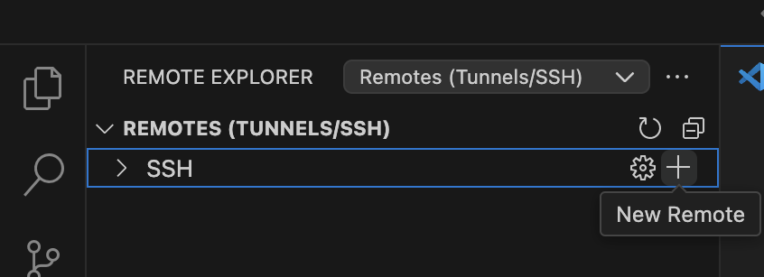
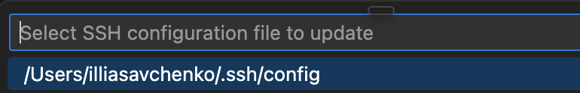
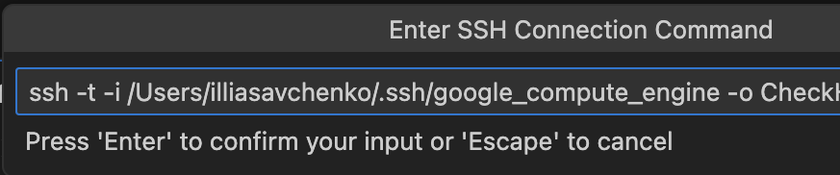
5) VSCode: Generate config for connection to your machine
Go to remote explorer, click on plus sign:
4) Choose your config file (usually the first one)
5) Done! You’ve added your VM to ssh config
2) Paste the copied output into the field. Change /usr/bin/ssh (or whatever you’ve got) to just ssh:
3) press enter

Slide 14
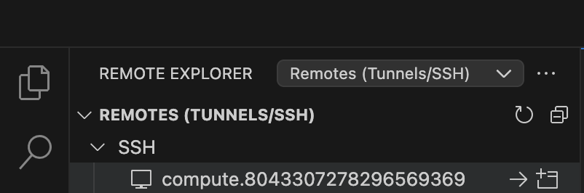
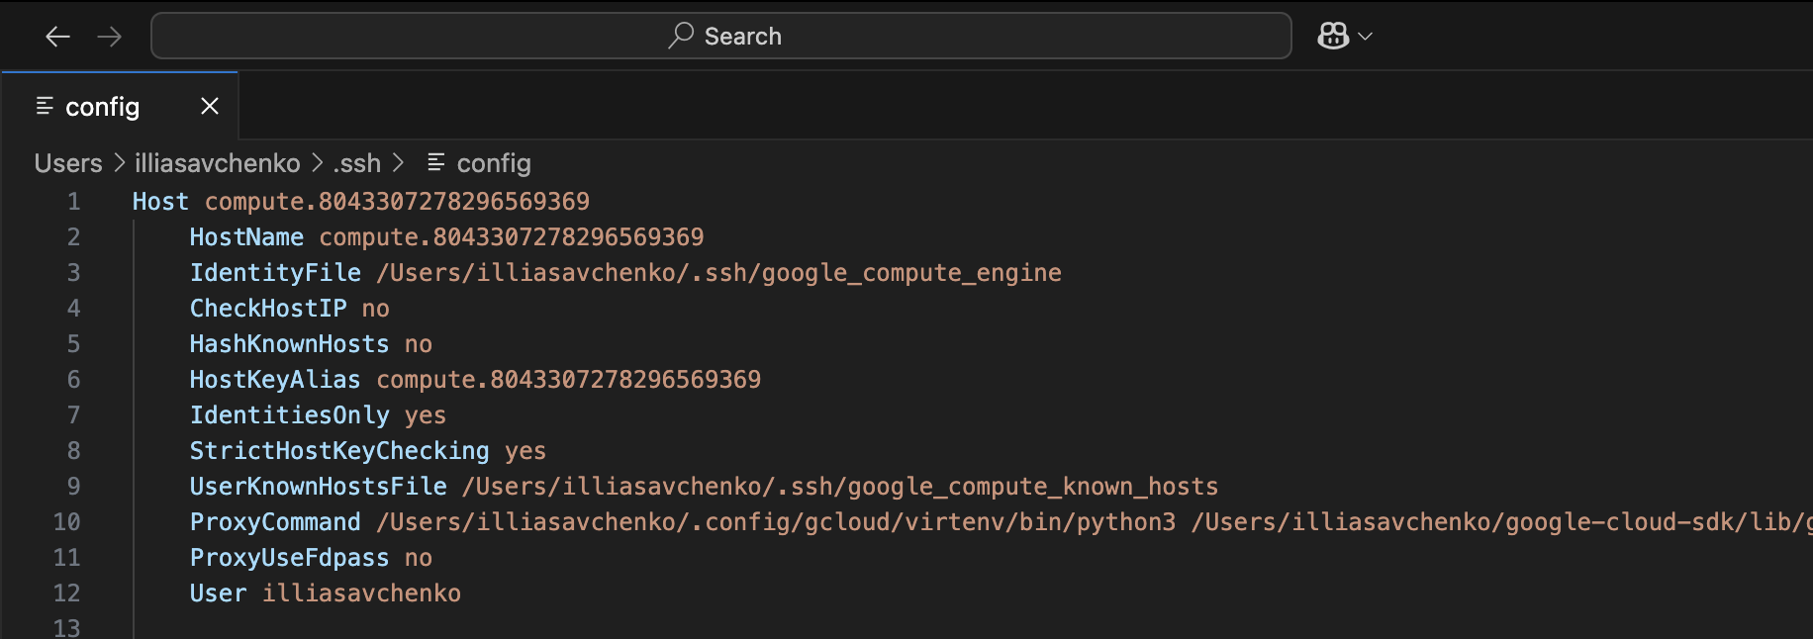
5) VSCode: Connect to VM
1) Congrats! Now that you’ve added your VM to ssh config, you should see this in your Remote Explorer:
and this in your config file:

Slide 15
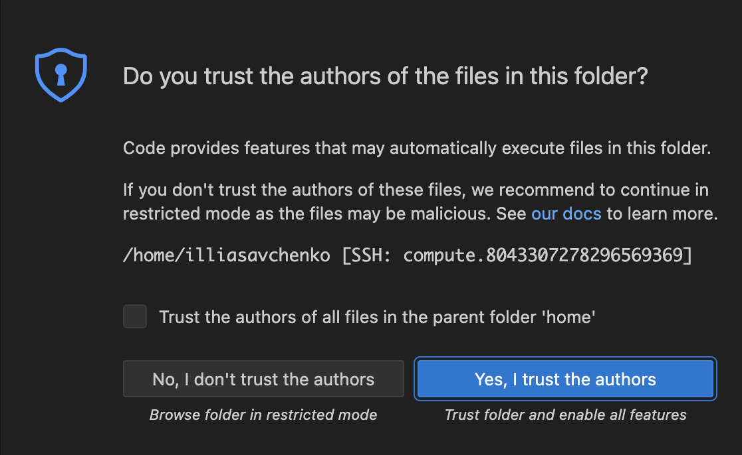
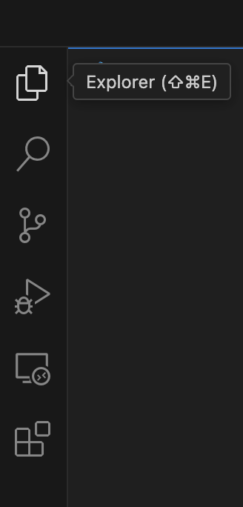
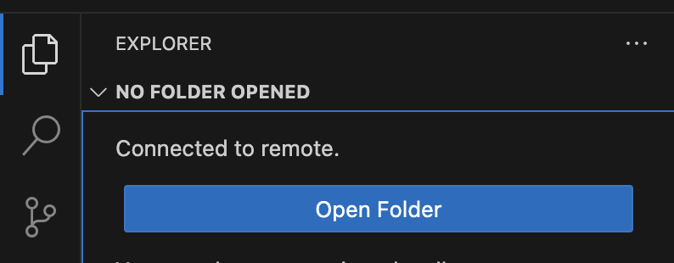
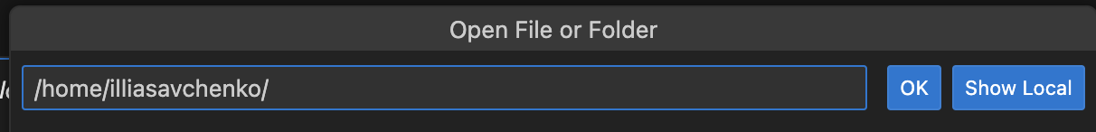
5) VSCode: Connect to VM
1) Click here to connect:
2) When connected:
your_username/

Slide 16
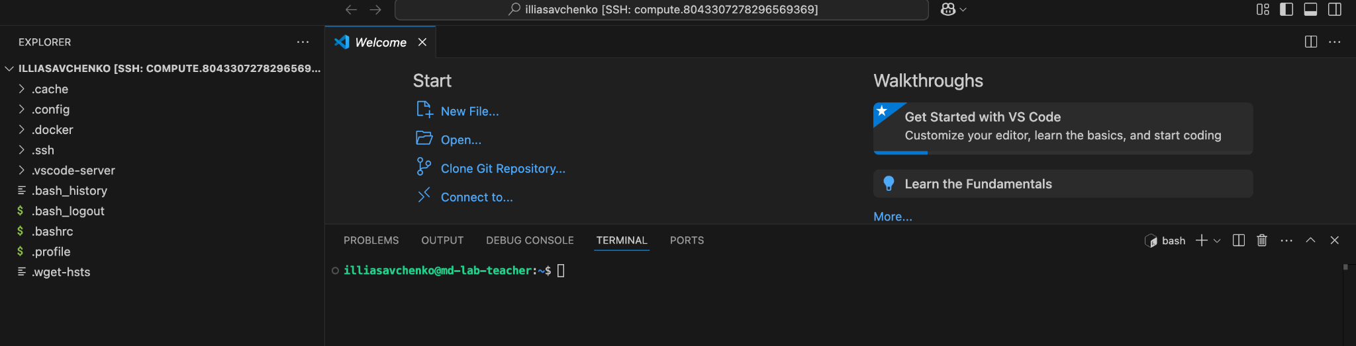
5) VSCode: File Explorer in your home folder
1) We did it! Now you can see this:
It has all you could ever dream of - File System (and you can transfer files in and out just by drag and drop), other VSCode extensions which work right inside your VM (You can visualize pdb structures on remote machine 🤯), terminal and so on

